Slide 1




Mental Health in Graduate Education:
What Faculty, Friends, and Family Can Do
Julie R. Posselt
University of Southern California
jrposselt@gmail.com
@JuliePosselt

Slide 2
Acknowledgements
Financial support
  Spencer Foundation
  National Academy of Education
  National Science Foundation
Research assistance
  Theresa Hernandez
  Kimberly Reyes
  Kamaria Porter
  Aurora Kamimura
  Kelly Slay
Research participation
  Partnership with Healthy Minds Network
  Students, Alumni, Faculty, and Staff interviewed

Slide 3
Lydia
Notes:
And when I saw Lydia from across the courtyard for our second interview, I didn’t even recognize her. One year ago, as a second-year doctoral student in a STEM field at a famous research university, she had been polished and put together, her height and posture the perfect embodiment of the strength and confidence she exuded in our interview. Today, with her head hanging, eyes framed with huge bags, rumpled shirt awkwardly untucked on one side, my first thought was that it must be someone else.
This sequence of noticing, of questioning, of looking more closely and then recognizing is routine for the type of cultural sociology I do. We want – for ourselves and our audiences—to see apparently familiar things in the social world as if for the first time again. We think that questioning what you know by looking more deeply is one of the best ways to learn about social phenomena, where the data are not as easily measurable, and where the measures we have are marked by error bars most physicists would scoff at. It’s a different kind of knowing, this understanding or as Wittgeinstein called it, verstehen. It’s neither generalizable nor appropriate for verification in the same way that knowledge in physics is, and no doubt there are some in the physical sciences—even in this room – who think of it as useless. And today I’ll share with you a study that uses this type of data as well as one that uses more familiar large-scale quantitative data.
By looking the second time and seeing with fresh eyes, though, we believe we can more deeply comprehend whatever thing we think is worthy of our study and to grasp its significance. In my case, it was upon the second look, as I realized that it was Lydia, that I wondered whether I had caught her on an off day. Maybe something in me wanted to assume an off day, knowing that it’s walk in the park to study students in distress. But no, as I would learn over the next ninety minutes in our second interview of the project, this was not an off day. This was, for Lydia, a very typical day in fact—and her hanging head and baggy eyes, sadly, as much an embodiment for her wellbeing this year as her perfect posture had been a year before?
There are some details I can’t share about the story that resulted in this change of affect for Lydia. An Ivy League-educated Black woman, she had chosen the university where we met after receiving admission offers to a dizzying array of graduate programs. She will no doubt be among the top prospects for faculty jobs in her fields – if she decides to choose academe. You see, academe failed Lydia. It allowed the faculty mentor whom she moved across the country to study with to persist in a pattern of sexual harassment – him gathering honor after honor in prominent circles, her slipping away from the university and her research as often as she could.

Slide 4
Motivation:
Institutional Change in STEM Graduate Education
Structures that promote diversity: Who is present/ absent? At what rates?
Cultures that promote inclusion: Whose interests & needs are served by typical practices and norms?
Education that promotes equitable outcomes.
Whereas most undergraduates experience the campus as the most salient context, graduate student learning and life are at the levels of the department, lab/group, and individual advising and mentoring relationships.
We’ll create more sustainable patterns of participation when we critically reflect upon the worlds that students inhabit and how to make them more humane.
Notes:
Move from participation as presence to participation with a sensitivity to power dynamics

Slide 5
Motivation:
Graduate Student Mental Health
Rising rates of undergraduate depression & anxiety diagnoses
Rising demand for treatment in undergraduate counseling centers¹
Untreated mental illness contributes to graduate student dropout²
Dearth of multi-institutional, multi-disciplinary research about mental health in graduate education
Costs for: Students, Their scholarship, Health of scholarly communities, Institutional financial interests, and the Labor market.
1 American College Health Association, 2012
2 Turner & Berry, 2000; Wilson, Mason, & Ewing, 1997
Notes:
In academia, an enterprise focused on the life of the mind, mental health carries special salience and direct bearing on one’s ability to fully engage in the work.

Slide 6
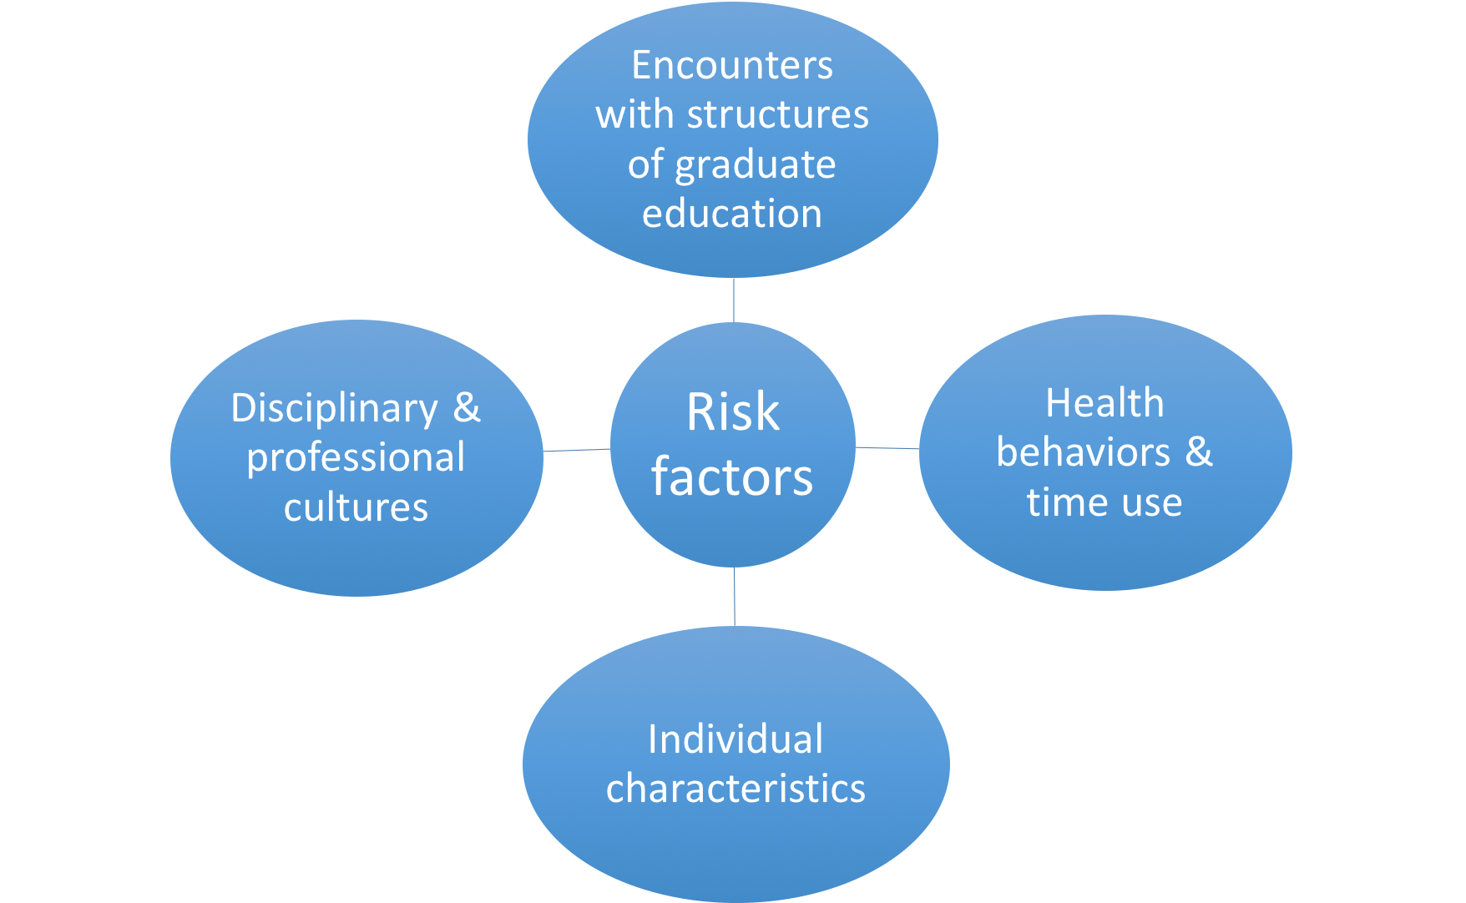
Literature:
Families of risk factors
  May also reflect patterns of self-selection.
May also be secondary outcomes
Notes:
Key papers to mention
Hyun
Indeed, when surveying a national sample of African Americans and Latino graduate students, the Council of Graduate Schools found 62% reported frequent or occasional worries about their mental or physical health (Sowell, Allum, & Okahana, 2015, p. 38).

Slide 7
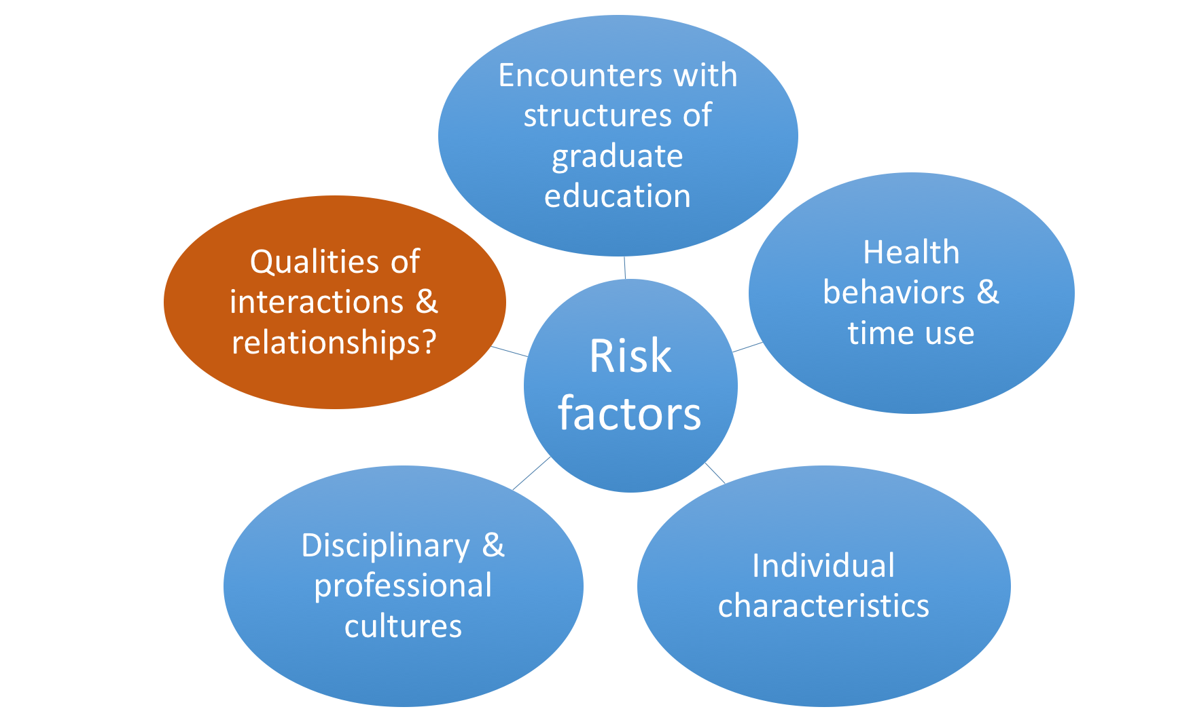
Literature:
Families of risk factors

Slide 8
Limitations of prior research
Inattention to context & key relationships
Sampling
  Non-random, often single institution samples
  Studies isolated to one or a small handful of disciplines/ fields of study.
Construct validity
  Most studies rely upon self-reported survey data about how one ”feels” (e.g., subjective well-being)
  Subjective indicators do not account for behavioral and normative dimensions of depression & anxiety (Perring, 2010).

Slide 9

-How do risks of depression and anxiety vary by social and disciplinary backgrounds?
-How do perceptions of support, discrimination, and competitiveness associate with probabilities of positive screenings for depression and anxiety?
-To what extent do support from family and friends, and perceived competitiveness in classes, moderate relationships of discrimination with depression and anxiety?

Slide 10
What are the forms & sources of faculty support experienced by PhD students in STEM who identify as women, Black, and/or Latinx?

Slide 11
Theoretical perspectives
Role strain
Self-determination theory
Systemic, role-related inequalities elevate stress more than short-term, isolated incidents.¹
Risk factors in socio-organizational contexts exacerbate/ moderate individual-level vulnerabilities to mental health among young people.²
Autonomy, Competence, and Relatedness drive motivation and wellbeing.
Discrimination or weak support, in a context centered on becoming an independent scholar, will compromise sense of
  ability (ie, competence & autonomy)
  belonging (ie, relatedness)
1 Kahn et al, 1964
2 Bowman, 2013
3 Deci & Ryan, 2015

Slide 12
Concurrent mixed methods research design
Large-scale, quantitative
PhD program-level, qualitative
Prevalence of and risk factors for depression & anxiety
(69 universities; 21 fields).
Role of racial discrimination, competitiveness, & support with respect to depression & anxiety¹ ²
Comparative case study of learning environments & underrepresented student wellbeing in high-diversity graduate programs at 2 universities.
Phenomenology of faculty support
  Faculty behaviors & organizational processes that explain wellbeing amid efforts to diversify. ³ ⁴
1 Posselt, J., & Lipson, S. (Nov 2016). Competitiveness and mental health in the college classroom: Variations across social identities
and fields of study. Journal of College Student Development 57 (8), 973-989.
2 Posselt, J. (under review). Graduate student mental health in the US: Prevalence and risk factors within and across fields of study.
3 Slay, K., Reyes, K., & Posselt, J. (in press). Bait and switch? Representation, climate, and the tensions of diversity in graduate education.
4 Posselt, J. (2018). Normalizing the Struggle: Dimensions of Faculty Support for Doctoral Students and Implications for Persistence and Wellbeing. Journal of Higher Education.
Notes:
Graduate school holds a variety of threats to student mental health– some of them profound and relatively rare like Lydia’s experience with sexual harassment, and some of them mundane and common, like ambiguous expectations or worries about the job market. Broadly, the goal of this project was to capture social forces related to graduate student mental health. I wanted to obtain a macro level picture through the first large–scale quantitative analysis of prevalence and risk factors associated with depression and anxiety. And, to complement this with knowledge that can directly informs educational practice, I’m conducting a qualitative analysis of the forms and sources of support that graduate students construct as salient to their wellbeing.
This project reflected a shift for me, having spent most of the last ten years conducting research the structure of access to elite institutions and graduate education. Having spent a lot of time examining the competition for access to these sectors of education, I wanted to explore the wellbeing of underrepresented students who do enroll and how wellbeing relates to institutional efforts to increase diversity

Slide 13
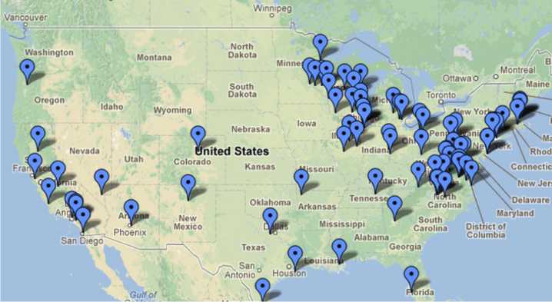
Methods:
Healthy Minds Study
2007-2013
N_{i}=20,888 graduate & professional students randomly sampled from
N_{j}=69 universities
62.5% masters programs
26.7% PhD
5.7% MD
6.7% JD
61.4% women
69% white
Notes:
annual web-based survey of mental health and related issues as well as service utilization
% master’s is lower than the 81.1% in national population of graduate and professional student population.

Slide 14
Methods:
Dependent Variables
From the Patient Health Questionnaire (PHQ-9)
Depression: Symptoms in the last 2 weeks; PHQ-9 score cut-off for any depression, major or moderate (>10, range: 0-27).
  1=Positive screen; 0=Negative screen
Anxiety: Symptoms in the last 4 weeks; PHQ score algorithm for any anxiety (panic disorder and/or generalized anxiety disorder).
  1=Positive screen; 0=Negative screen
  Anxiety only analyzed for 2007-2012 sample.

Slide 15
Interactions & relationships
Frequency of racial discrimination
Perceived competitiveness in classes
Health behaviors & time use
Exercise more than 2 hours per week.
Amount of time per day spent on schoolwork.
Individual characteristics
Race/Ethnicity
Fields of study & degree programs
Support
Ability to speak with professors if mental health affected performance
Degree program
High subjectivity (Arts, Music, Humanities, Architecture)
Reside on campus.
Age
Gender
Sexuality
Mother Education
Not a problem
Tight
A struggle
Family
Friends
Field of study
Masters
PhD
JD
MD
Other
Father Education
Finances are

Slide 16
Methods:
Data Analyses
2. Risk Factors
1. Relative Prevalence
Logistic regressions, with variables entered in four blocks to reflect families of risk factors.
Constructed non-response weights
Applied fixed effects for
  Campus
  Survey year
Interaction effects estimated to examine support and competitiveness as moderating factors.
LR tests to assess model fit
Cluster analysis tests for significant differences in prevalence of depression & anxiety relative to overall sample.
Visualized through a linear dendrogram.
Notes:
Consider this a detailed, descriptive analysis.

Slide 17
Findings:
Cluster analysis & logistic regression

Slide 18
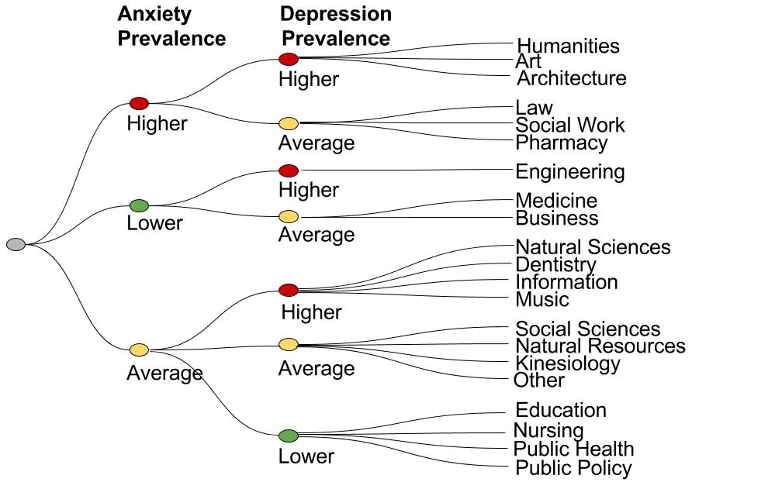
Notes:
For the hierarchical cluster analysis, I grouped and compared fields of study according to their prevalence of depression and anxiety, relative to prevalence in the sample overall. Three fields stand out for having both higher rates of depression and anxiety: humanities, art, and architecture. However, there are no fields that have both lower prevalence of anxiety and depression than the sample as a whole. The fields with lower than average rates of anxiety are engineering, medicine, and business; lower than average prevalence of depression is found in four other professional fields: education, nursing, public healthy, and public policy.

Slide 19
Individual Characteristics
If OR>1, then odds are higher than reference group; If OR<1, then odds are lower than reference group
 | Anxiety |  | Depression
 | Odds Ratio |  | Odds Ratio
Single (vs. partnered) | 1.05 |  | 1.61 | ***
Female (vs. Male) | 1.65 | *** | 0.98
LGBTQ (vs. straight) | 1.82 | *** | 1.46 | ***
International | 0.54 | *** | 1.06
African American | 0.47 | *** | 1.18
Latino | 0.82 |  | 1.04
American Indian | 1.74 | * | 1.26
Arab American | 1.36 |  | 1.43 | *
Asian American | 0.77 |  | 1.09
Pacific Islander | 0.98 |  | 0.36
Age (in years) | 0.93 | * | 0.95 | *
vs. white
Notes:
Looking at the ways individual characteristics are related to the probability of screening positive for anxiety and depression, the items in bold represent statistically significant relationships, and the number of asterisks denotes the p-value, or confidence that this is due to the relationship occurring in reality and not due to chance.
I find that single graduate students have a 61% higher odds than partnered graduate students of screening positive for depression, female-identifying students have a 65% higher odds of depression, and LGBTQ students have significantly higher odds of both depression and anxiety.

Slide 20
Interactions and Relationships
 | Anxiety |  | Depression
 | Odds Ratio |  | Odds Ratio
Discrimination often | 2.97 | *** | 2.23 | ***
Discrimination sometimes | 1.92 | *** | 1.58 | ***
Discrimination rare | 1.10 |  | 1.21 | *
Classes very competitive | 1.66 | *** | 1.35 | ***
Support from family (5 point scale) | 0.78 | *** | 0.79 | ***
Support from friends (5 point scale) | 0.94 |  | 0.89 | ***
Can talk to advisor about mental health (Y/N) | 0.66 | *** | 0.61 | ***
Can talk to other faculty about mental health (Y/N) | 0.79 |  | 0.79 | *
vs. Discrimination never
Notes:
Next, here are the

Slide 21
How do support & competitiveness moderate the relationships of discrimination with anxiety?
Outcome | Frequency of Discrimination | Low Friend Support | High Friend Support |  | Low Family Support | High Family Support | Very Compet. Classes
Anxiety | Often | 10.3*** |  | 8.3*** | 15.1*** | 8.0*** | 11.2***
Anxiety | Sometimes | 5.6*** |  | 4.5*** | 8.3*** | 4.4*** | 6.1***
For students reporting the lowest level of support from friends and family, frequent discrimination is associated with 10.3 and 15.12 percentage point increases in the probabilities of screening positive for anxiety.
Notes:
The final set of findings considers how support from family and friends, and perceived competitiveness in one’s classes, may moderate the relationships of discrimination with depression and anxiety. I calculated effects at all five levels of family and friend support, but report here only the highest and lowest.
For students who report the lowest level of support from friends and family, respectively, frequent discrimination is associated with 10.3 and 15.12 percentage point increases in the probabilities of screening positive for anxiety. For students reporting the highest levels of support from friends and family, on the other hand the increase in the probabilities of anxiety and depression are smaller: at 8.25 and 8.01 percentage points, respectively.

Slide 22
How do support & competitiveness moderate the relationships of discrimination with depression?
Outcome | Frequency of Discrimination | Low Friend Support | High Friend Support |  | Low Family Support | High Family Support | Very Compet. Classes
Depression | Often | 12.3*** |  | 9.1*** | 14.8*** | 8.9*** | 10.7***
Depression | Sometimes | 6.7*** |  | 4.9*** | 8.0*** | 4.8*** | 5.8***
For students reporting the lowest level of support from friends and family, frequent discrimination is associated with 12.3 and 14.8 percentage point increases in the probabilities of screening positive for depression.
Notes:
Students reporting the lowest levels of friend and family support have 12.31 and 14.79 percentage point increases in the probability of depression when they experience frequent discrimination; however, at the highest levels of support, the mental health risks of frequent discrimination are significantly reduced, though still high, at about 9 ppt for support from both friends and family. Among students who perceive their classes as very competitive, frequent discrimination is associated with probabilities of anxiety and depression that are 11.22 and 10.67 percentage points higher than they are for students who read their classes as less competitive.
* We can take from this competitiveness is associated with increased mental health risks that come with frequent discrimination, while support weakens that risk.

Slide 23
What can family and friends do to support graduate students?
Stay in communication about how the student is experiencing :
  Transitions: New home, first semester of candidacy, going on the job market
  Intense times: First year of classes, writing the dissertation
  Exams: Final exams, Prelim/Qualifying exams, Oral defense
Encourage healthy habits
  Sleep, Exercise, Water/Diet
  Music, Laughter
Provide community & companionship
  Importance of down time/taking a break
  Suggest a hobby or regular activity together
  Ensure they are not alone for holidays
Recognize warning signs¹
  Withdrawal from social activities
  Intense mood swings
  Self-medicating
  Excessive worrying, persistent anger
  Changes in regular habits
  Physical ailments without clear causes
1 National Alliance on Mental Illness (www.nami.org)

Slide 24
Straightforward, honest communication is best.
To get conversation started…
If they resist…
I’ve heard that [the first semester of graduate school] can be really hard. How are you doing?
I’m concerned about you [or situation]. Can we talk about what you’re going through?
I can see this is a difficult time, and I care about you.
I hate seeing you struggle like this
How can I help you find help?
Are you getting the support you need?
Are you comfortable talking with your advisor about this?
Who else do you have to talk to?
Who do you feel comfortable sharing with?
Who has helped you with situations like this in the past?
Are you seeing a counselor?
Are there other ways I can help?

Slide 25
You can offer support to a friend or family member struggling with mental health with these simple actions:
Finding out whether they are getting the care they need. If not, connect them with help
Express concern & care, ask questions, listen actively
Helping with everyday tasks
Including them in your plans:
“continue to invite him or her without being overbearing, even if your friend or family member resists your invitations.”
Educate others so they understand facts & do not discriminate
Normalizing need for professional support, to reduce stigma
https://www.mentalhealth.gov/talk/friends-family-members

Slide 26
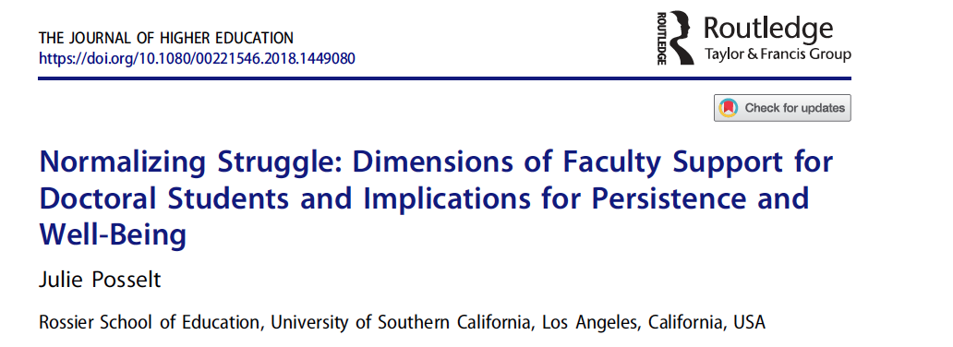
Notes:
Moving from the forest to the trees, my goal for the second study was to understand how students themselves conceptualize support. The first phase of this work examined the sources of support students thought of as most important, and then the paper you see here examined specifically what forms of support from faculty were most important for their persistence and wellbeing. I’ll be sharing with you the stories and perspectives of students, rather than aggregated statistics.

Slide 27
Distinctive features of doctoral education
Learning expectations: To increasingly operate in the mode of cognitive complexity that research demands, on topics at the edge of current disciplinary boundaries, while reducing reliance on the familiar supports of their peers.
Interconnectedness of subject-matter learning (i.e., skills and content) and professional socialization (i.e., identity development and the adoption of professional norms, knowledge, and discourse)¹
This literature suggests that holistic faculty support
will likely have several dimensions:
Academic, Psychosocial, Sociocultural, Cognitive
1 Weidman, et al., 2001; Austin, 2002; Walker, et al., 2008
Notes:
I grounded this analysis in a review of the literature on what makes learning in doctoral education unique, and this review elicited a couple of important thing. The first concerns the unique learning expectations placed on graduate students, which are for them to develop what’s called progressive independence. This means working ever more independently in intellectual activities that require cognitive complexity, on the edge of what is currently known. A second major theme about what makes doctoral education unique is the interconnectedness of students developing subject matter skills and content knowledge as well as developing the identity, norms, and discourse expected of scholars in one’s field.

Slide 28
Findings:
Faculty perceived as last resort for academic support.
Uncertainty about how to appropriately approach faculty or worries about possible repercussions
Worry that admitting a need for academic support would compromise their standing
“If a student isn’t necessarily performing, then they [faculty] really have no vested interest in that student.”

Slide 29
Findings:
Supportive faculty reframe how students think about the difficulty of graduate school.
“I had already failed two classes that everyone else passes, and I was on academic probation because my GPA was so low… I came to my advisor and I was just kind of brutally honest with him, like, “I’ve read the handbook. The coordinator has talked to me … You guys finally found out how dumb I am.” And he was just not concerned… He was like, “That’s not going to happen. You can’t do anything about failing your class. You can’t go back and change it because it is there. So now let’s focus on what you need to do to continue.” That mindset just blew my mind… He believed that I could continue, nothing was going to happen, that it is okay, and let’s focus on how to fix this.”
Reframing situational struggles to reduce anxieties
Notes:
What faculty do around academics that’s just as important as supporting their academic work is helping them reframe the difficulty of graduate school, effectively encouraging a growth mindset.

Slide 30
Findings:
Supportive faculty reframe how students think about the difficulty of graduate school.
Reframing situational & work struggles to reduce anxieties
Disrupting self-doubts about belonging with personal validation
‘Your application passed every one of those hurdles.’ And I remember thinking, ‘Jeez, if I’d known that’s what it was, I wouldn’t have even applied. I’m glad I was so dumb when I applied.’ Again, it is that mentoring that she wanted me to feel powerful… She wanted me to know that I didn’t get in by accident… that ‘We did what we could for the first part, but the rest was all you.’
Notes:
the former emphasizes external matters—the work and its inherent difficulty—whereas personal validation focuses on qualities in and of students. Both involve shifting mindsets, but whereas reframing struggle changed how students saw the work and the path before them, validation reframed students’ sense of themselves as doers of that work and members of the academic community (Rendón, 1994).

Slide 31
Findings:
Supportive faculty reframe how students think about the difficulty of graduate school.
Reframing situational struggles to reduce anxieties
Disrupting self-doubts about belonging with personal validation
Keeping it real about race, gender, & more in the academy.
‘I don’t need you to be my parent, but just kind of see me’…. I needed mentors so I can be like, ‘I don’t understand what’s going on here. I’m feeling isolated.’ When I first got here, I went to my mentor and was like, ‘White people are crazy, and I don’t understand’ [laughs]. I don’t understand what’s happening in this interaction and I need some help.’
Notes:
A third facet of

Slide 32
Findings:
What do faculty do to facilitate supportive faculty-student relationships?
“He has the power and the position and the willingness to go to bat for students. I think that is one of the most important things about, I guess, for me, mentoring. And I guess in terms of an advocate as well. He’s definitely been around and I know is busy, but he does make time for students. I’ve been able to talk to him about a lot of the issues I’ve had with my advisor and kind of figuring out ways in which to navigate.”
Visibility
Responsiveness
Notes:
There were four frequently discussed ways that faculty facilitated supportive relationships with students. First, simply, they were around.

Slide 33
Findings:
What do faculty do to facilitate supportive faculty-student relationships?
“Other professors, you meet them and they’re so smart and they have these giant, ‘I’m a physics professor at the University of Such and Such’-sized egos. We had one professor who said on the first day of class, ‘If you stay, you will be physicists.’ And he really did his best to kick your ass. Arthur, on the other hand, was hard and his class was really difficult, but he always joked that there would be no dissatisfied customers. If you did poorly on an exam, you could go and talk to him.”
Visibility
Responsiveness
Downplay status
Cultivate trust

Slide 34
Cutting across the conditions that facilitate supportive faculty-student relationships is effort on the part of faculty to humanize the mentoring relationship and engage on common ground.

Slide 35
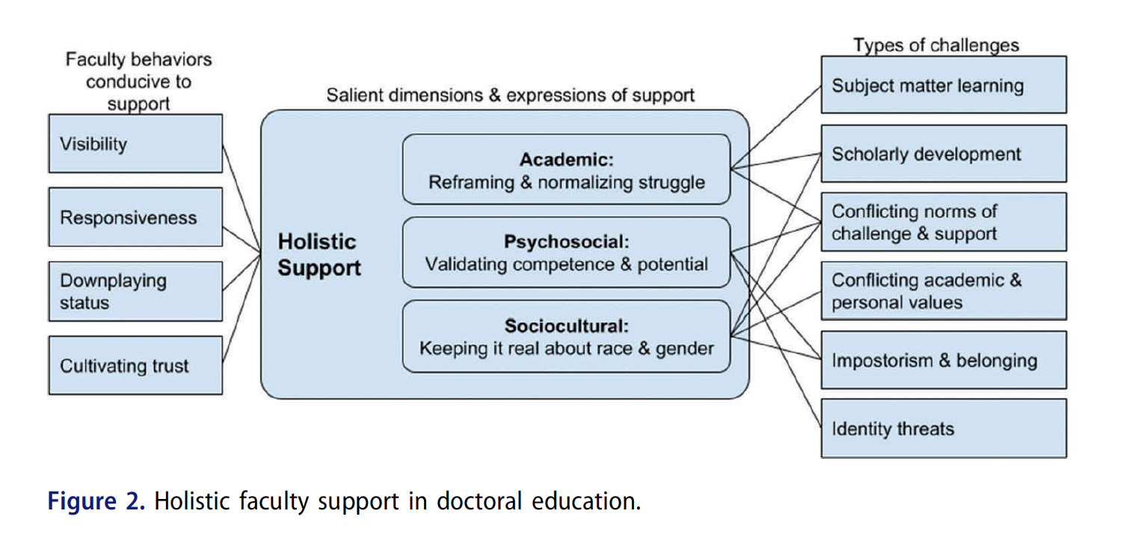
From: Julie Posselt (2018): Normalizing Struggle: Dimensions of Faculty Support
for Doctoral Students and Implications for Persistence and Well-Being, The Journal of Higher
Education, DOI: 10.1080/00221546.2018.1449080

Slide 36
Discussion
In competitive environments and those with opaque standards of excellence, social comparison may be especially common
(Dijkstra, Kuyper, van der Werf, Buunk, & van der Zee, 2008).
Supportive relationships may buffer students from environmental risk factors such as racial discrimination & the isolation that accompanies it.
Faculty support can protect the senses of competency, belonging, and autonomy that are important for motivation, but which are easily compromised in graduate school.
Notes:
3 of 4 fields that were coded as a “1” for subjectivity were also the three that the hierarchical cluster analysis identified as having significantly higher prevalence of anxiety and depression: humanities, art, architecture. We can interpret this set of findings from a perspective that links role strain and symbolic interactionism. In competitive environments and those where standards of excellence are opaque or individualized, social comparison may be especially common (Dijkstra, Kuyper, van der Werf, Buunk, & van der Zee, 2008), either because there is a sense of a zero-sum-game about success and/or expectations on members are ambiguous. This is consistent with Siegrist’s (1996) findings that experiences in high-effort, low-reward conditions come with adverse health effects. However, it is also worth noting that I observed competitiveness related to depression and anxiety only at the highest levels of competitiveness, which is consistent with the notion that some competition is positive or neutral but too much may compromise wellbeing.
Support and competition may be conceptually distinct, as are friends and classmates. However, the combination of a negative association between support from friends and depression/anxiety and a positive relationship for competitiveness in courses and depression/anxiety points to a common trend: the power of interactions and relationships with one’s peers.

Slide 37
Conclusions
Individual and socio-organizational factors are intertwined through experiences of key relationships.
Responsibility for establishing perceptions of support start with faculty. They have power, they need to take the lead. Establishing shared expectations is also important.
  Educators should attune themselves to & address factors associated with wellbeing.
  Funding relative to cost of living
  Discrimination in the micro-contexts that shape graduate student experience
  Quality of interactions & relationships
  Health behaviors matter
  Resilience to struggle, rejection, failure

Slide 38
Thank you!
Julie R. Posselt
jrposselt@gmail.com
@JuliePosselt

