Slide 1




Social Justice Driven STEM Education: Engaging Communities and Youth in Learning Science
Michael Barnett
Professor of Science Education and Technology
Boston College
Lynch School of Education
Campion Hall, Room 123
barnetge@bc.edu
@mikebarnett_BC
http://iuse.bc.edu

Slide 2
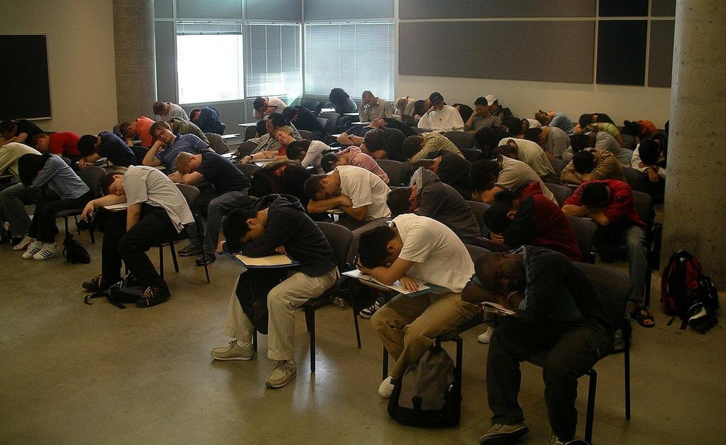
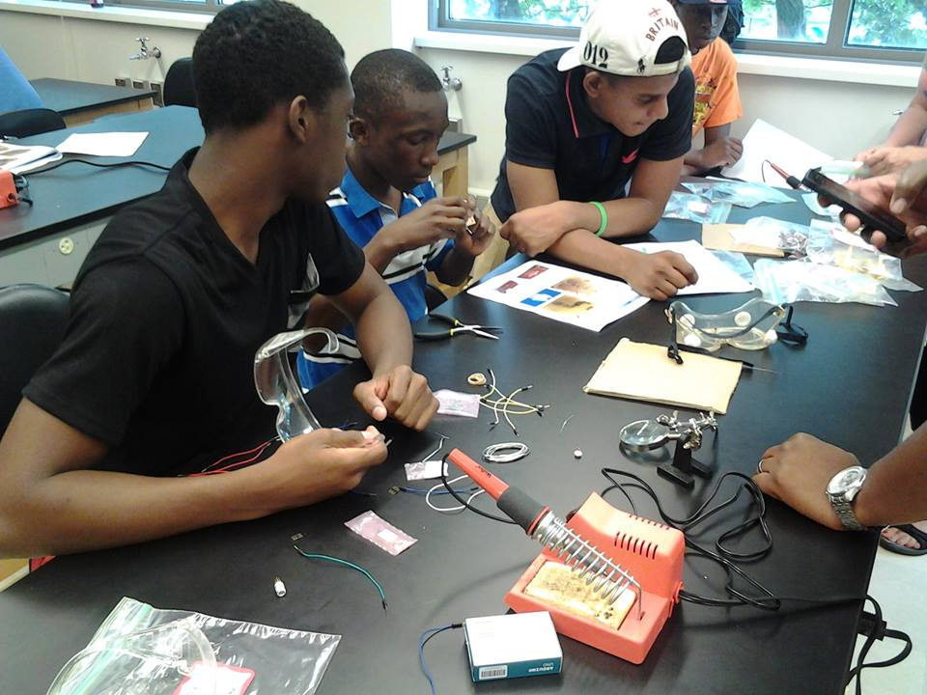
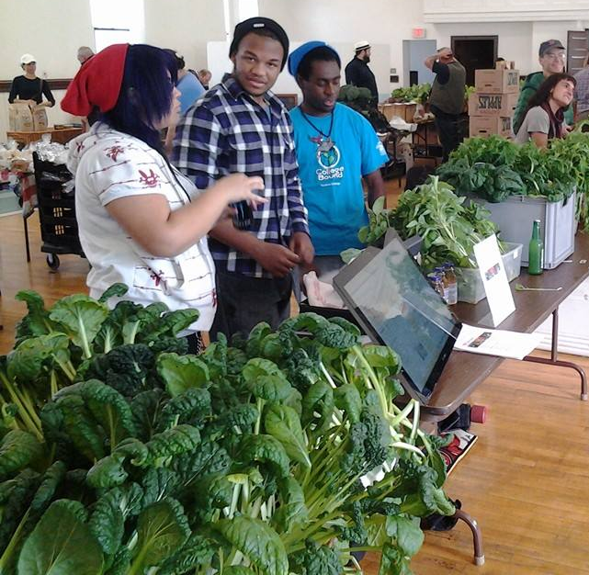
The Problem…
“We must prepare all students, including girls and minorities who are underrepresented in these fields, to be proficient in STEM subjects. And we must inspire all students to learn STEM” (p. X).
- Presidents Council of Advisors on Science and Technology, 2010

Slide 3
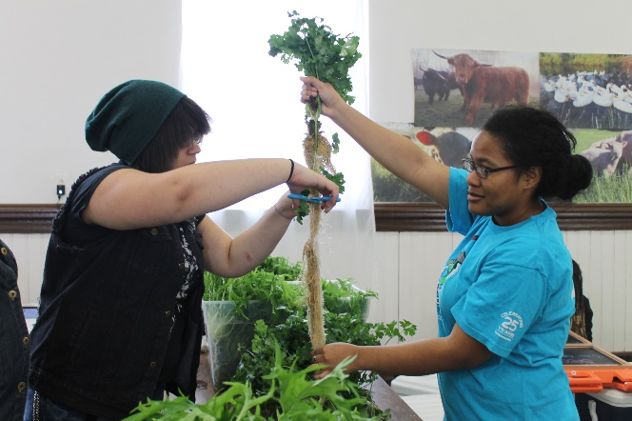
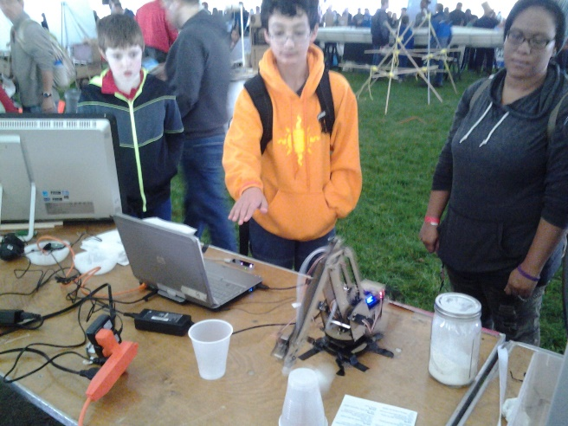
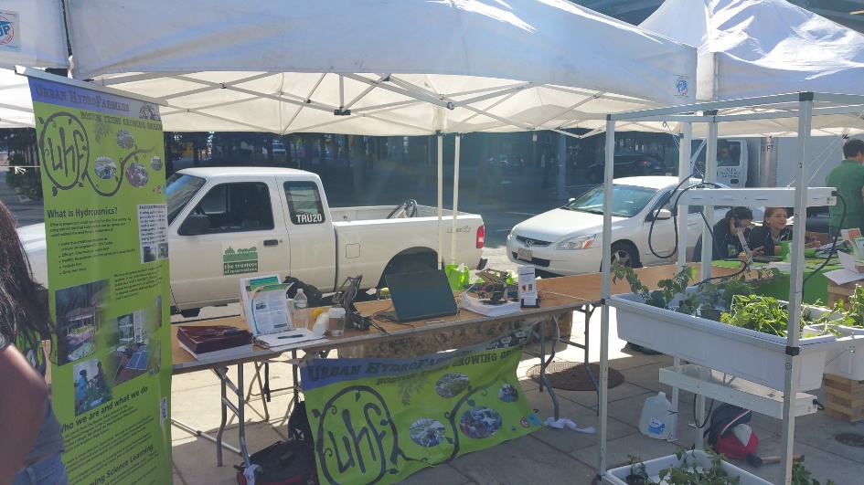
Overview
Frames for our work
Projects and Current work
Outcomes on Youth
Emerging work and recent projects

Slide 4

Poll : What do you remember?
When do you think you first became interested in science? (show of hands)
  Elementary school
  Middle School
  High School
  College

Slide 5
When do scientists and graduate students say they first became interested “science”?

Slide 6
When do scientists and graduate students say they first became interested “Chemistry/Physics”?

Slide 7
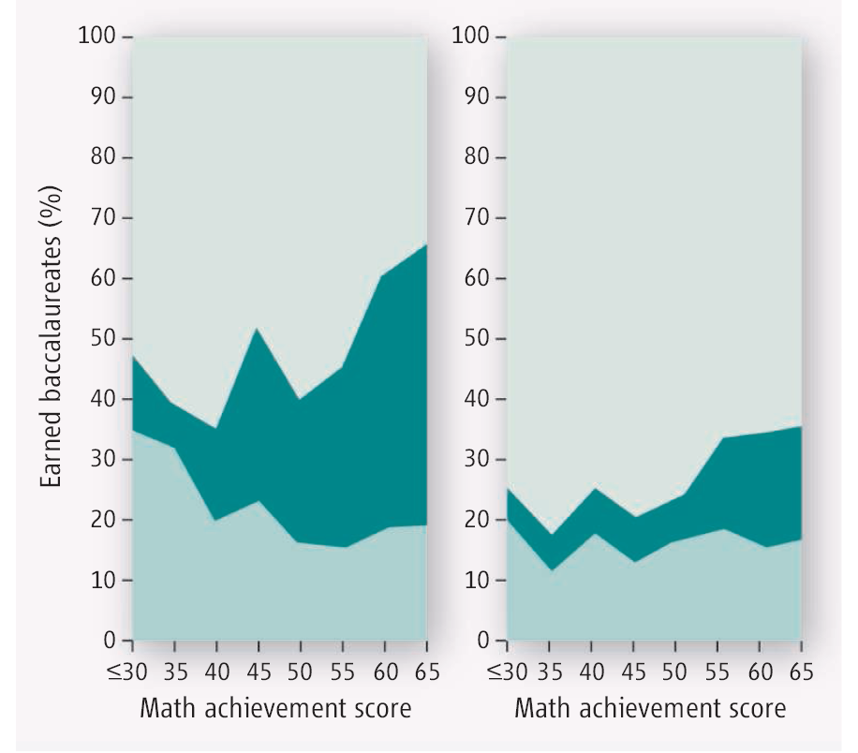
Expected
Science-related Career
Did Not Expect
Science-related Career
Students in 8th grade
Physical Sciences
Life Sciences

Slide 8
What constructs matter for STEM
STEM self-efficacious individuals persist longer to complete a task, particularly in the face of obstacles and adversity (Pajares, 2005; Zimmerman, 2000)
  Higher self-efficacy individuals find “hard” tasks as challenges rather than threats or barriers
Science interest is a predictor for studying STEM (Tai, 2006, 2012)
Career awareness and belief (hope) that one can obtain a STEM career predictor (Carter et al., 2010).
Your identity with STEM (Stets, et al., 2017)

Slide 9
Identity Discrepancy (Stets, et al., 2017)
Yourself
Others
Distance
Identity discrepancy is the distance between
  Your perception of yourself as a scientist
  Others perception of you as a scientist

Slide 10
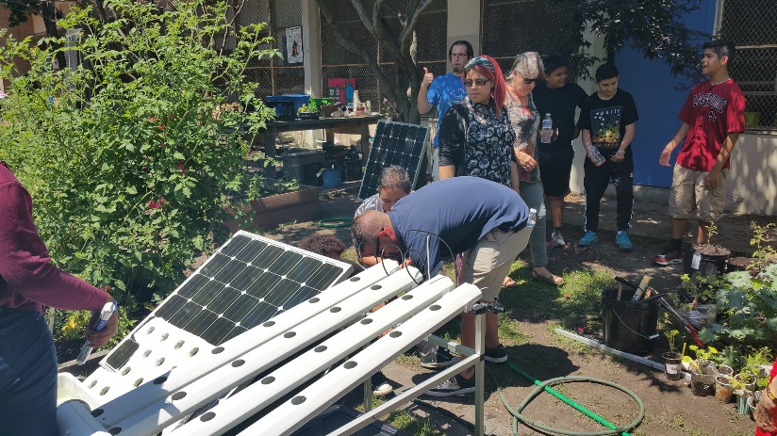
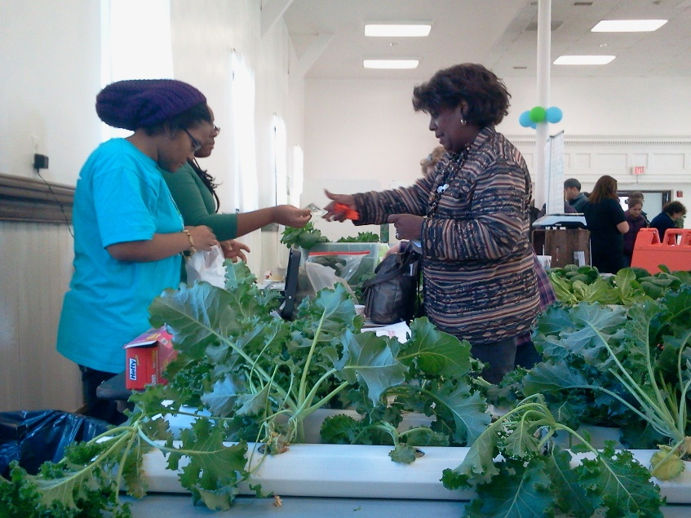
Build STEM around social justice
An important tenet of social justice education is that students become “empowered” when provided with opportunities to engage in learning that aims to rectify social injustices (Chubbuck & Zembylas, 2008; Nieto & Bode, 2008)
  Low income communities breathe different quality of air and have different levels of access to healthy food
Coupling scientific investigations with social action projects may provide spaces for students to experience academic empowerment alongside political empowerment (Dimick, 2012).

Slide 11
Our team at Boston College
Designing learning environments that generate youth/student interest toward science…
Social Justice Driven Projects that focus on youth from 7th through 12th grade
  My Science for Future Presidents course at BC (non-science majors are a pilot)
  Urban Agriculture: Food Access
    Designing and building hydroponic systems
    Food justice ambassadors training middle school youth
    This is shifting a bit to include transparent soil and climate change
  Urban Planning/ Air Quality
    Converting unused spaces into something useful
    Placing air quality sensors around the city
    What are the differences in the quality of air
  Converge Science Theatre
    Plays around science
    Soon to become a program where youth write their own plays
  iCREAT – engaging youth from 7th – associates degree
    Coding, Robotics, Mentoring

Slide 12
Conjecture Maps: Design-Based Research approach
Iterative design research informs day to day program structures with goal of improving practice and training and implementation of the program’s curriculum based upon both internal data and evaluation results.
The overall goal of the SEM research is to test the theories driving our work regarding how participation in our program impacts youth outcomes on STEM identity. Whereas, the summative evaluation is more focused on whether our work has met its goal.
Program Conjecture
Learning Experiences
Actors/Participants
SEM Research examines how program participation impacts outcome variables
Outcomes
To Broaden participation of youth requires engagement in STEM learning environments that empower them to solve problems of relevance and address a relevant societal need
Instructional Supports
Peer Mentoring
Food Justice Leaders
STEM Identity (interest and intentionality)
Teacher/FJ Leader Training
Curriculum (Career Exploration, Food Justice, Mentoring)
STEM Learning (hydroponics/GIS)
Research and Evaluation inform each other regarding outcomes and program design
Instruction/Mentoring
Community Engagement farmers markets, public conference)
Food Justice Ambassadors
Youth see STEM as way to impact social injustices and to design solutions
Summative Evaluation examines how program supports the development of social justice/ STEM initiatives in youth
Instruction/Mentoring
Food Justice
Middle School Youth
Career Exploration
Formative Evaluation informs the design and redesign of training aspects of the program
Program Structures
Evaluation informs the design of the overall program structures and how to improve the learning experiences at a program level
Seeding the Future: Social Justice/Food Justice Driven STEM Learning

Slide 13
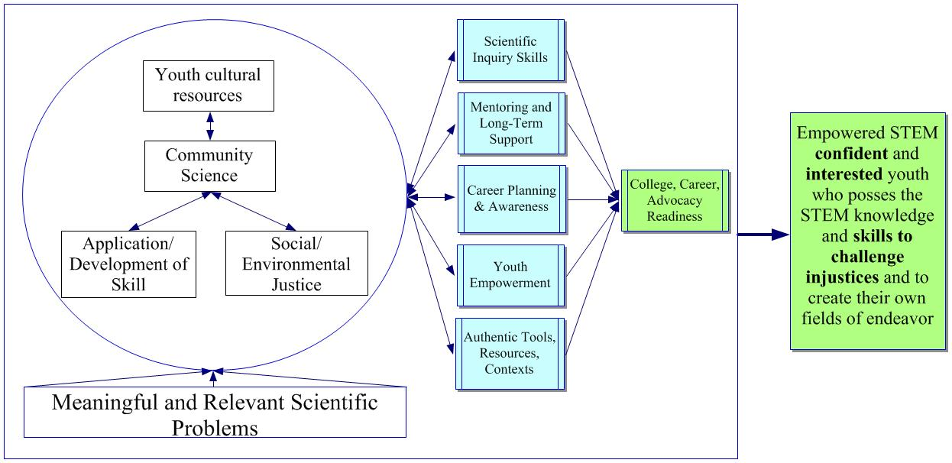
Social Justice + Supports

Slide 14
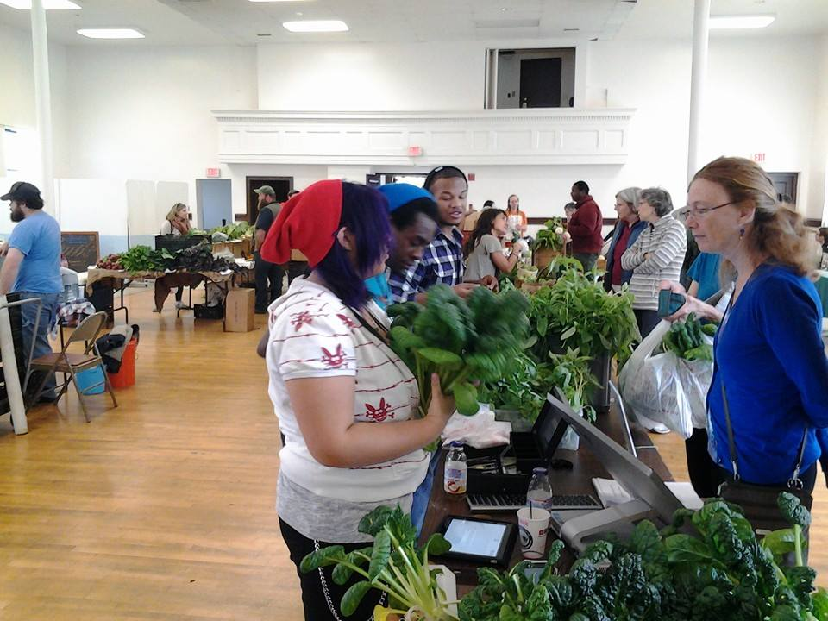
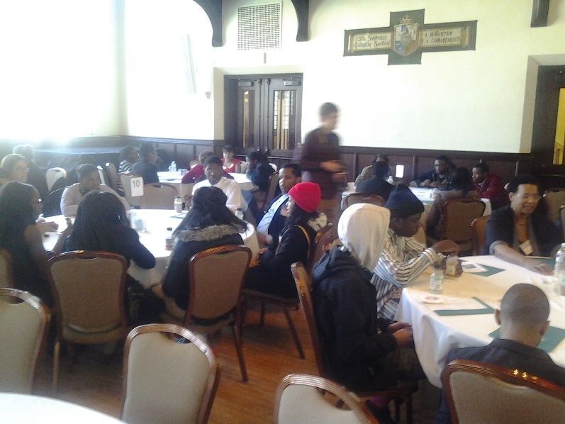
High School Youth OST Program
Youth from Boston Public Schools
  Out-of-school program
All grades (7th – 12th)
  Low income, first generation to college
Do not target the very top students
  Generally start with little or any interest in science
Strive to retain youth through 7th – 12th grade
  Mentoring and alumni program
  Now partnering with MentorNet
Around a 80% retention rate
Programming in STEM, Social Justice, Career exploration, College Preparation, College Mentors

Slide 15
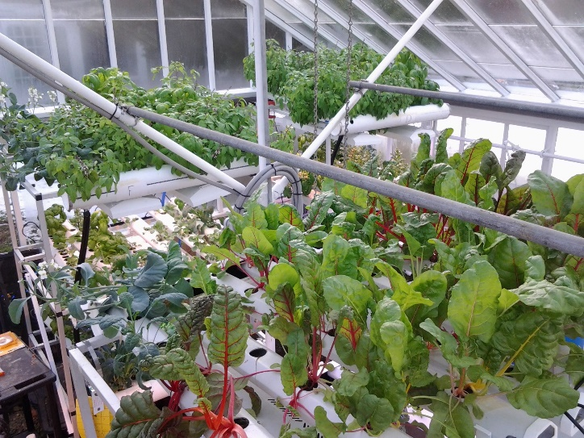
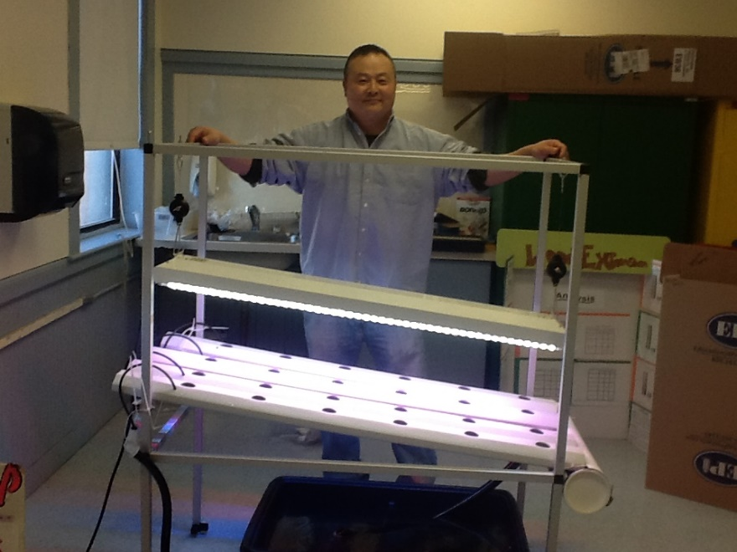
Integrating into classrooms
Currently
  Curriculum for classroom teachers
  Schools grow food in the back of their classrooms (outdoors in LA)
Lots of schools participating
  Teacher institutes, follow-up workshops
Scaling to China
  Hubei province has adopted our materials
75 out-of-school sites in Boston area (through STEM Garden, non-profit)
  Elementary focus

Slide 16
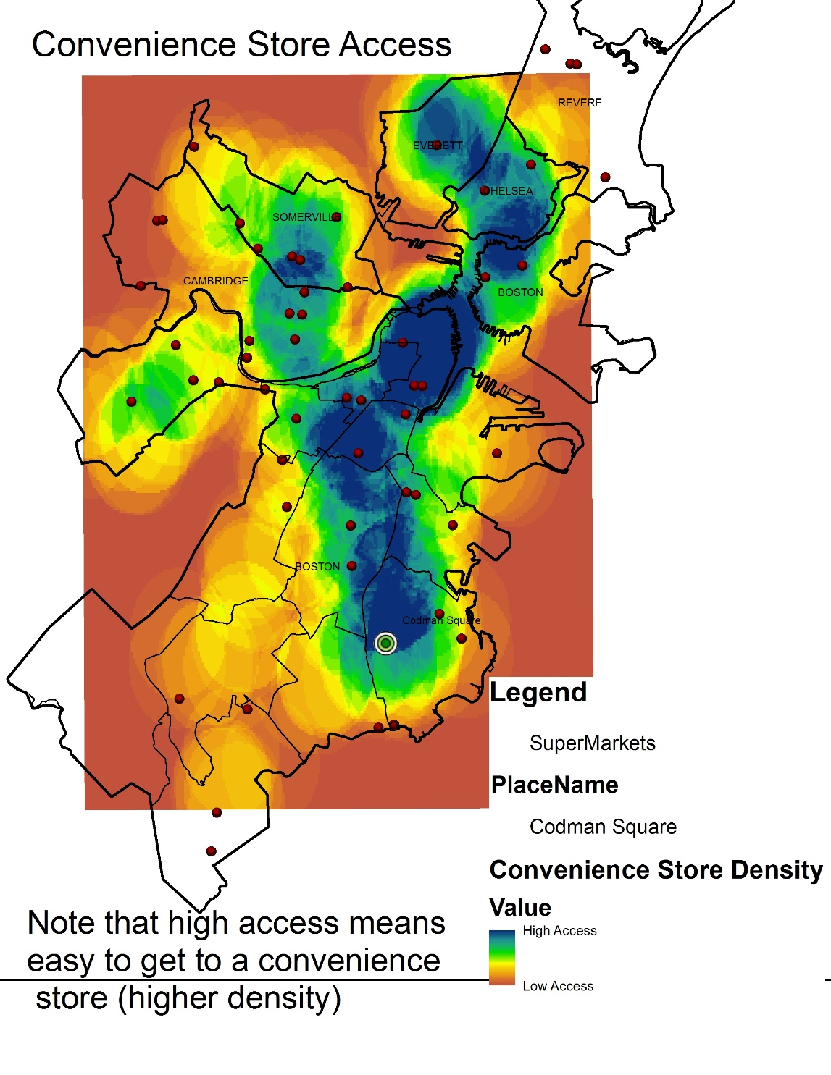
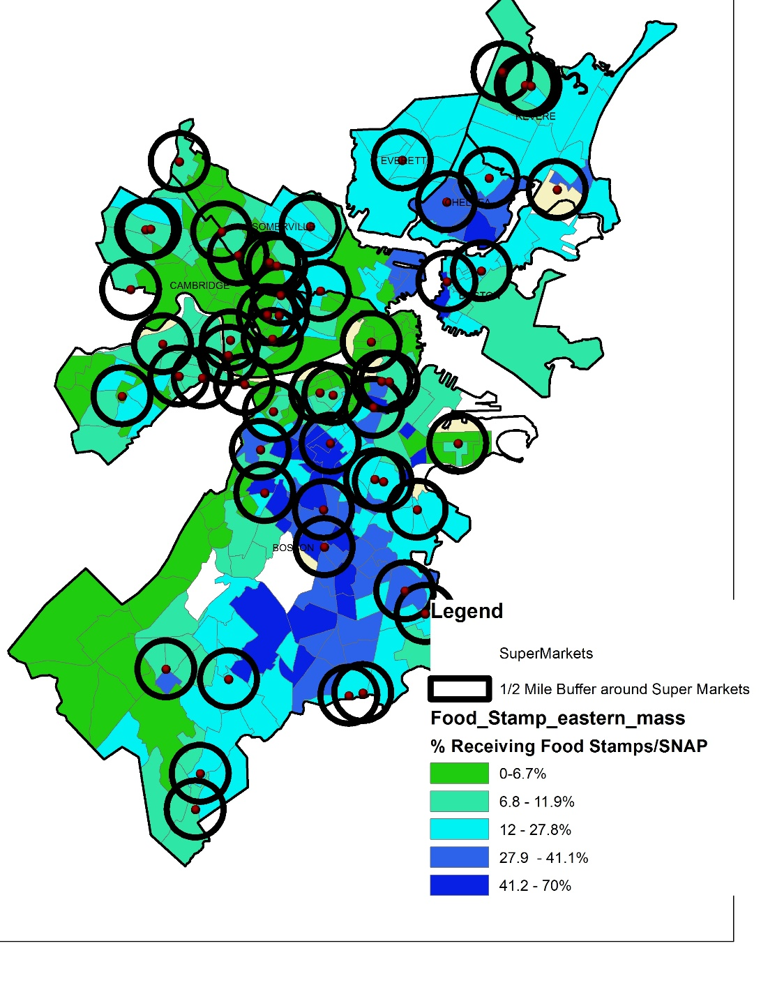
Food Justice: Science for Impact

Slide 17
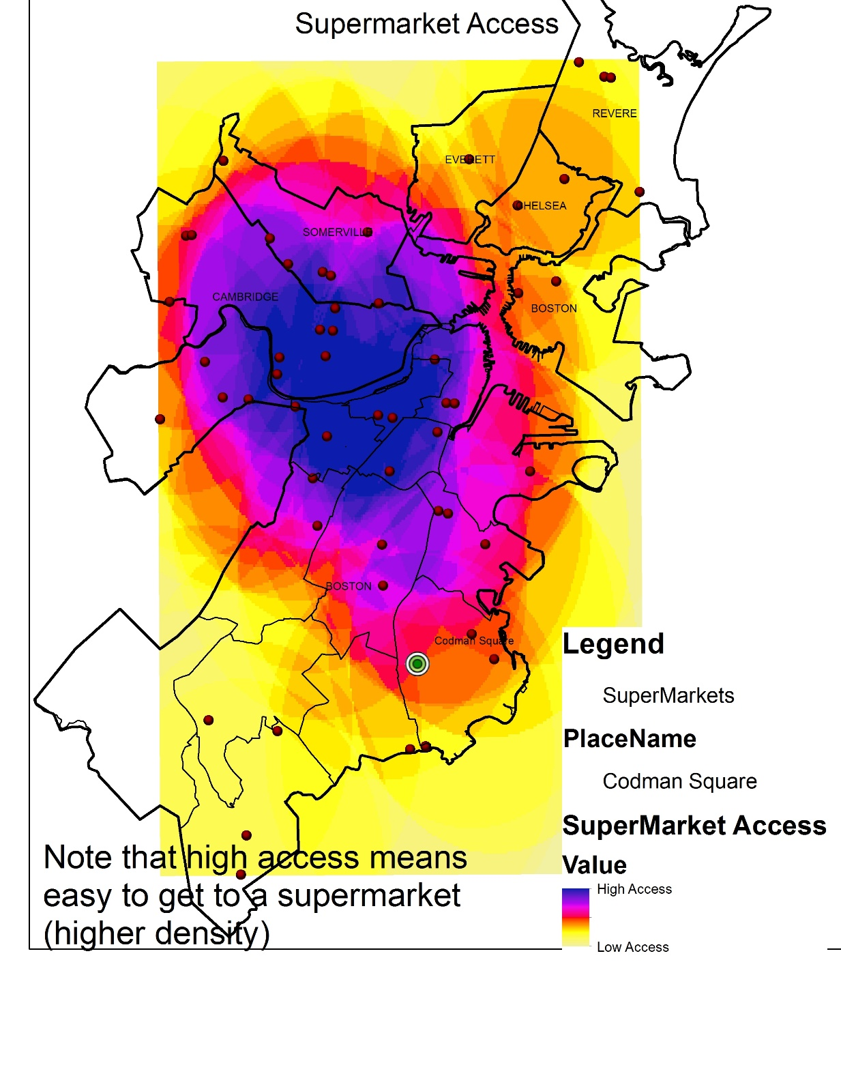
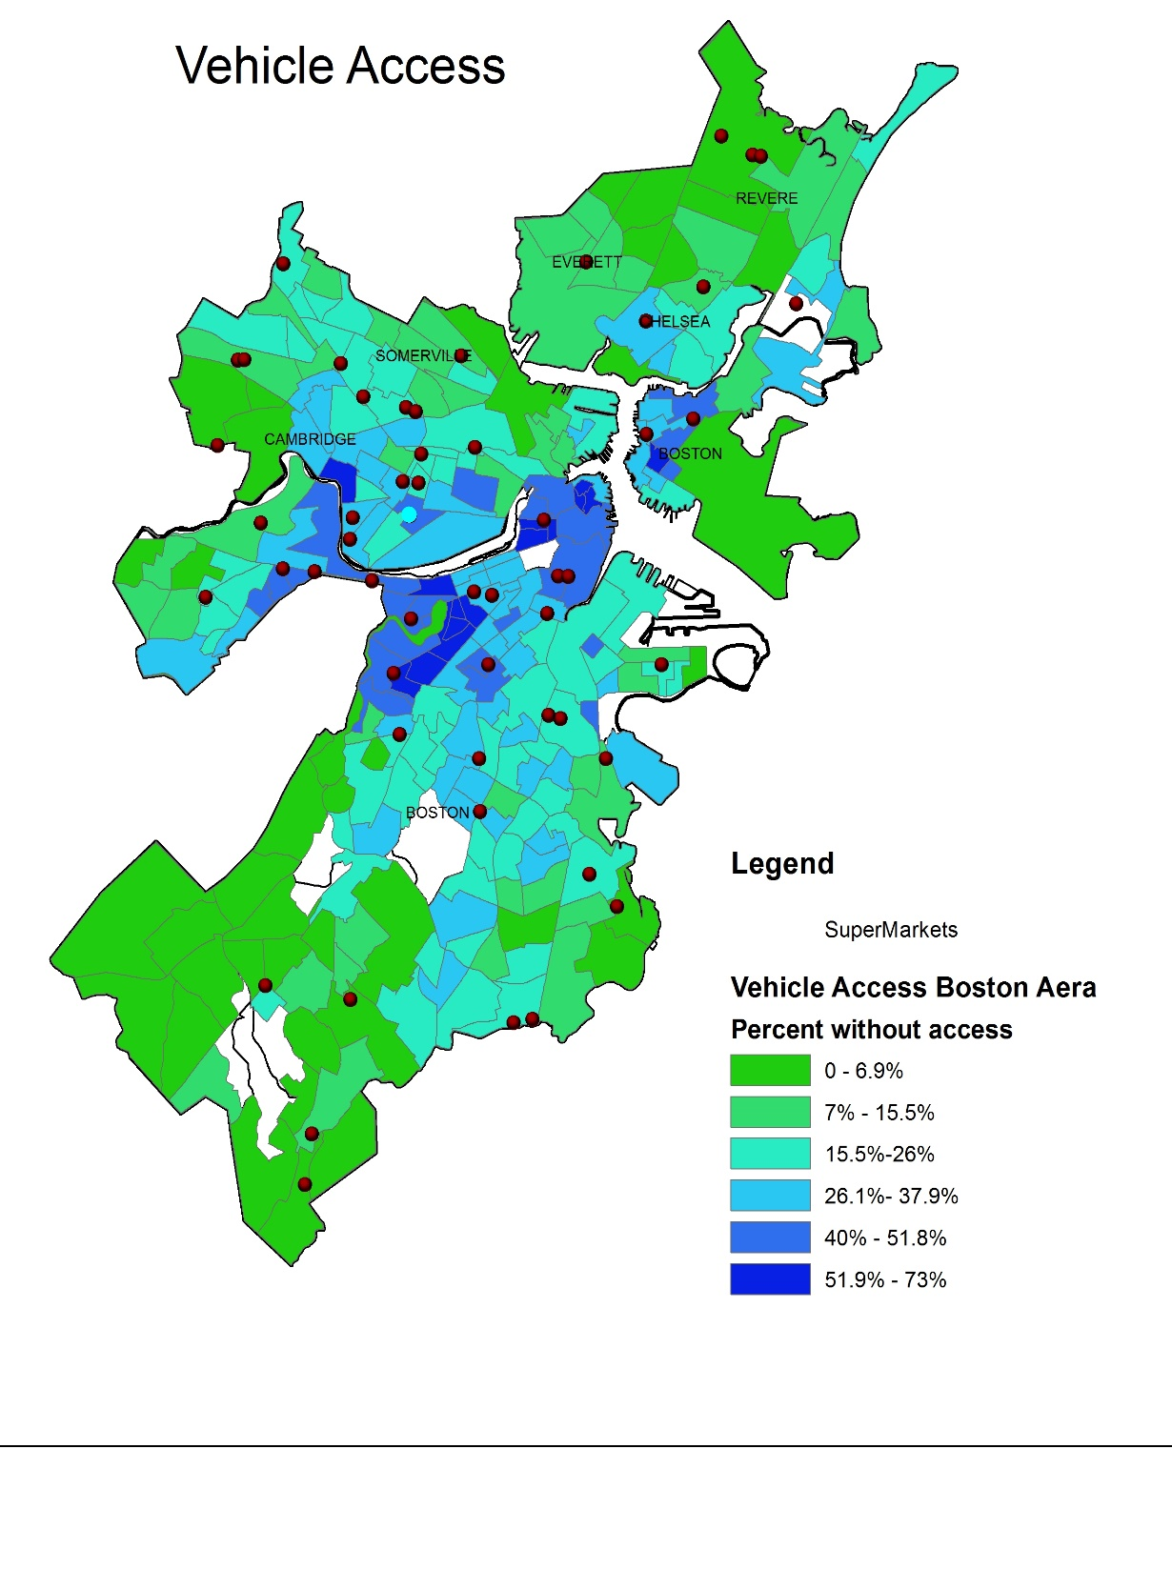
More Food Justice

Slide 18
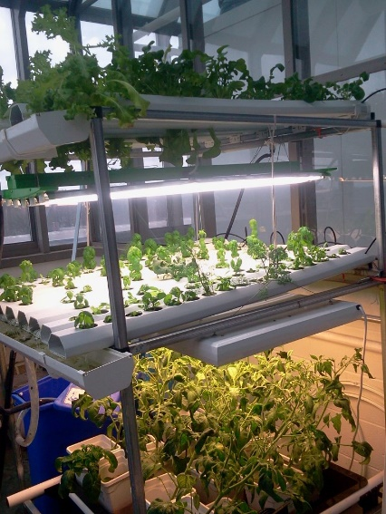
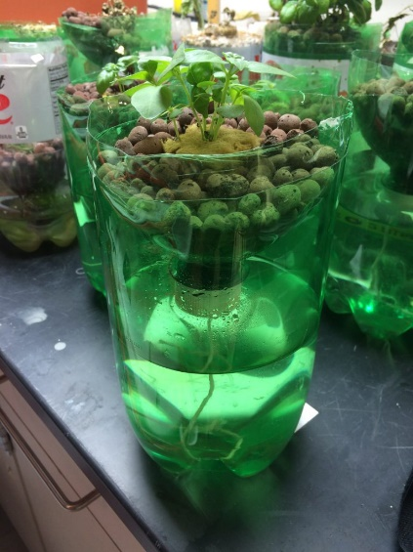
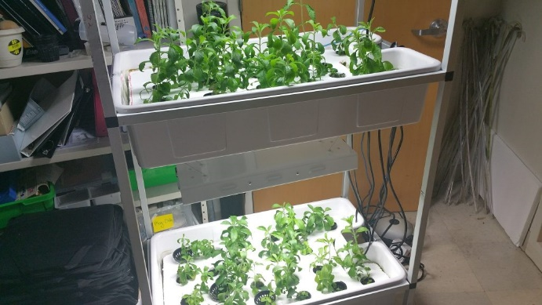
What we have been learning
The curricular structure is very modular
  Physics, inquiry, chemistry, business, alternative energy
  “Half-Baked” – we have no interest at all in teacher fidelity
    Flexible based upon teacher expertise and context
  Strong gains on “usefulness” of science and science relevance and thinking more about potential STEM careers that they did not consider
http://csl.nsta.org/2017/05/seeding-the-future/

Slide 19
Measures: Outcomes
Modified attitudes towards science inventory (Weinburgh & Steele, 2000)
  Focus on affective outcomes
  Good predictors on whether youth will study science later
Three subscales
  Anxiety toward science: 4 items, Cronbach’s Alpha .880
  Desire to do science: 5 items, Cronbach’s Alpha .982
  Self-Concept of science: 5 items, Cronbach’s Alpha .739
added
  Identity measures – 5-10 itmes, Cornbach’s Alpha .90
Elementary level
  Pre and Post test at three sites, n =234 (had many more youth participate) (a total of 350+ youth total participate)
    Only kept data that had both a complete pre and post
    Three sites with a range of teacher experience

Slide 20
What have we been learning…
A residue effect
HLM growth modeling analysis on students who stayed in the program
  Found significant growth over time over time
Outcome | β_{time} | t | p-value
Science self-efficacy | 0.12 | 6.51 | <0.01
Career planning | 0.08 | 3.06 | <0.01
Student ecological mindset | 0.15 | 8.66 | <0.01
Student work hope | 0.06 | 5.12 | <0.01

Slide 21
Confidence and Science
Number of students

Slide 22
What we are learning
A residue effect
HLM growth modeling analysis on students who stayed in the program
  Found growth over time over time
  Look at year 2
Comparison group showed decrease in same constructs (similar to Tai, 2012).

Slide 23
Gender Impact in OST
Note the large increase in Desire and increase in self-confidence for girls – across elementary sites
Score
Anxiety
Desire
Self Confidence

Slide 24
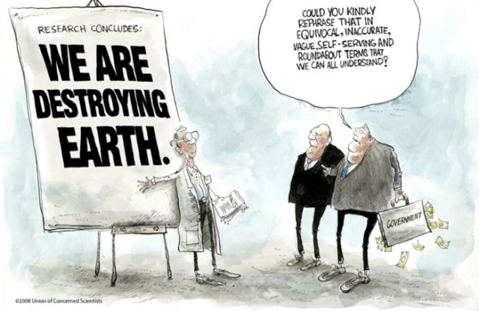
Science for Future Presidents
Non-science major course
130 – 150 students
Very little lecture
  All labs and lab modules with a focus on doing research
  2-5 week research investigations (hydroponics, air, soon transparent soil)
Modest Goals
  All students understand basic research practices
  Actively seek out science news to learn more

Slide 25
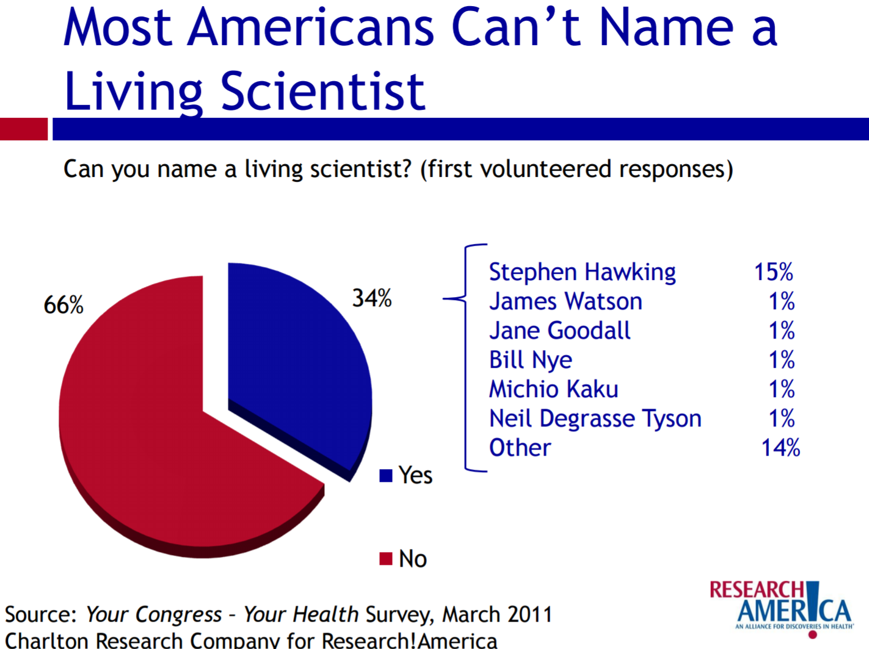
Part 2….

Slide 26
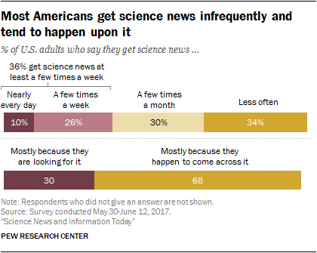

Slide 27
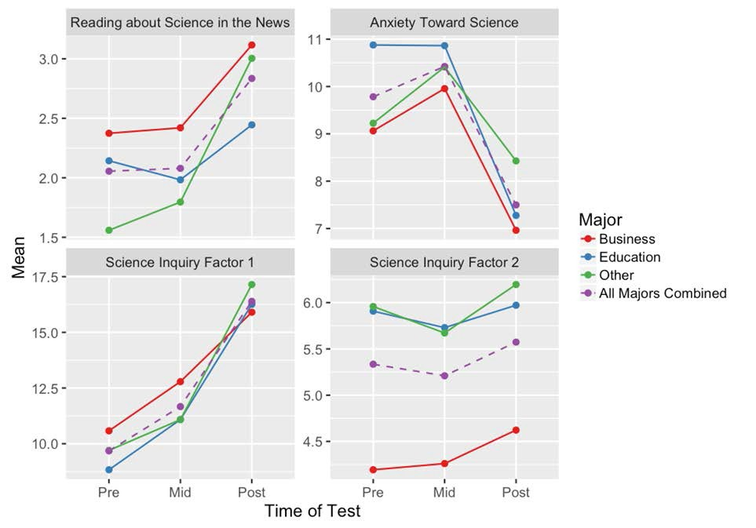

Slide 28
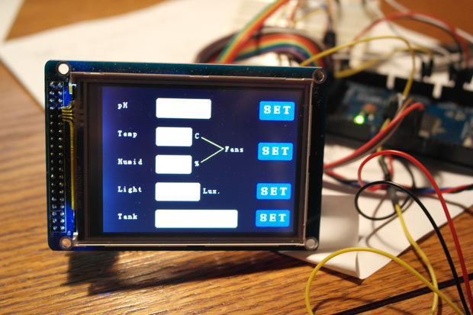
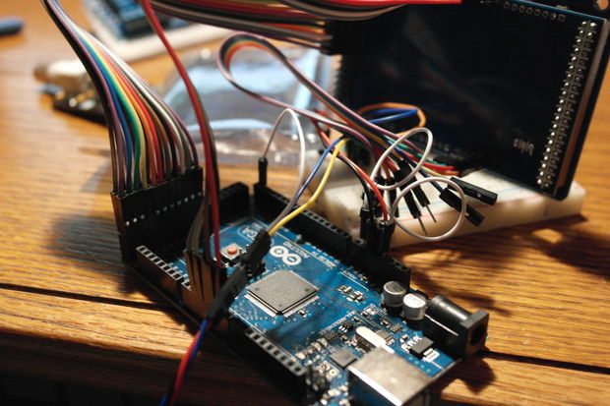
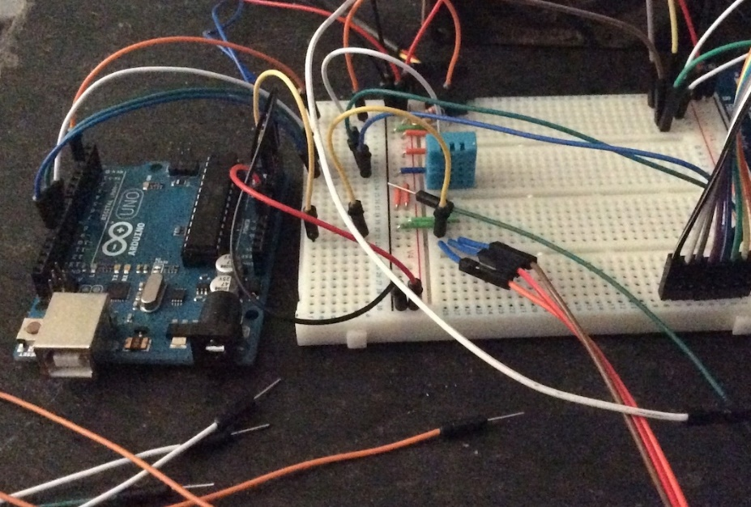
Next: Electronics, Hydroponics, Coding, and Transparent Soil
Learn to program microcomputers
  Automate hydroponic systems
  Manage pH
  Manage EC
  Learn to program

Slide 29
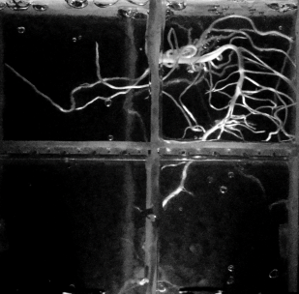
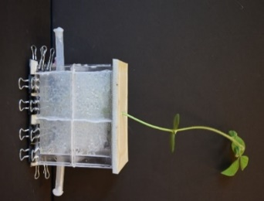
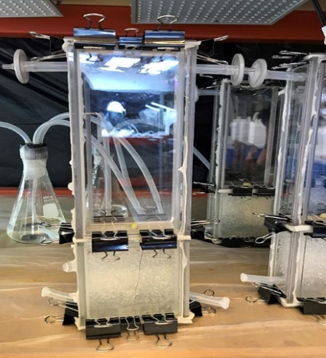
Next Steps
Partnership with Iowa State (Ludivico Cadamartiri) and UC-Boulder (Ben Shapiro)
Building “transparent soil boxes”
Inject a matching index of refraction liquid as the beads to get the transparency
1 of the 10 big ideas from NSF is phenotyping
  Turns out we have no real idea of how plants grow

Slide 30
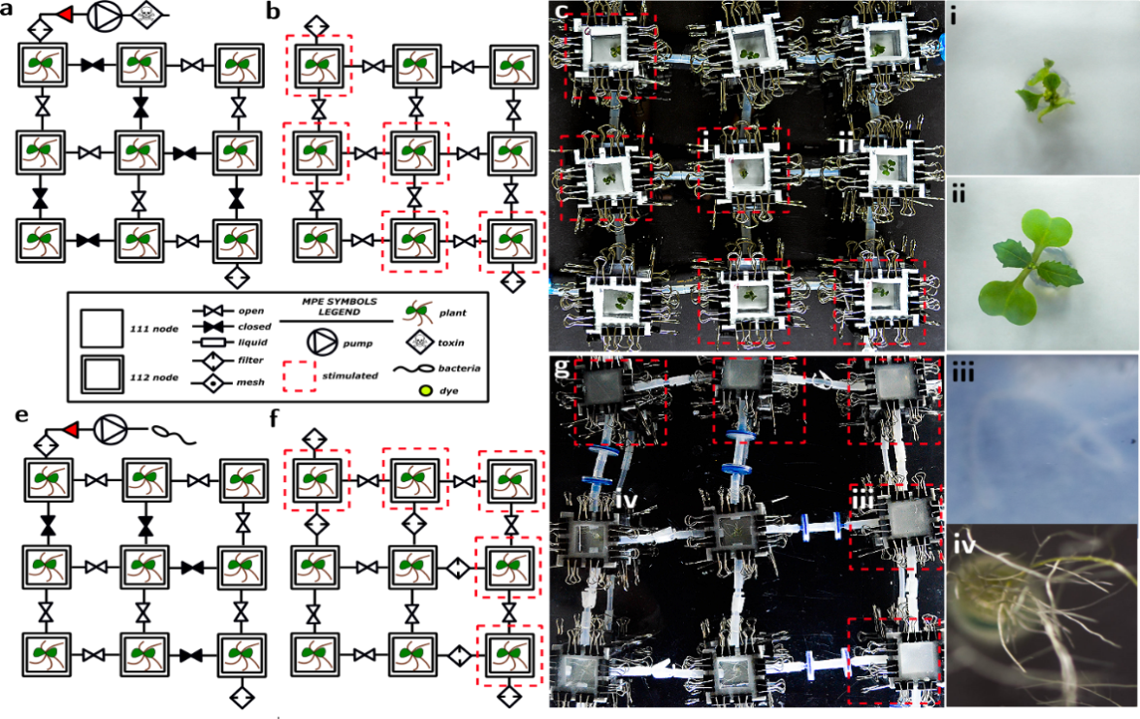
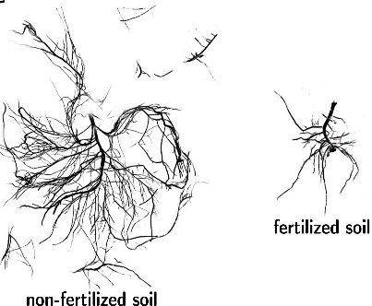
Conduct real research
Using microcontrollers
Conduct climate experiments
Pollutant impact
Manipulate variables like pH, air flow,
Examine impact of pollutants in farms and how pollutants are transmitted through a system

Slide 31
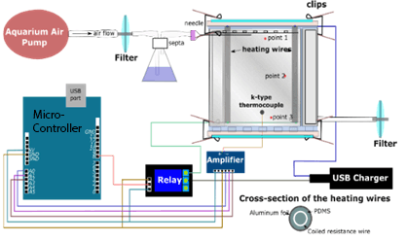
Sharing data: Electronics/Coding
Build boxes to control climate, collect data, monitor variables

Slide 32
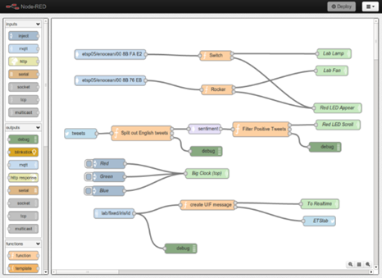
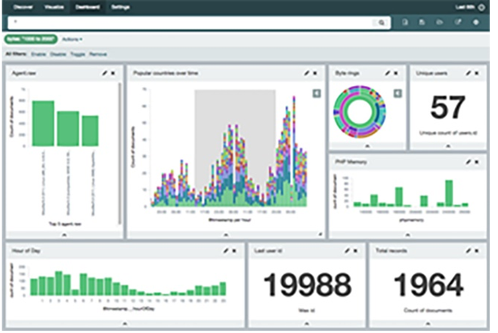
Sharing data: Electronics/Coding
Learn how to “code” to think about how to visualize and share data
Interested in engaging youth in primary and secondary research

Slide 33
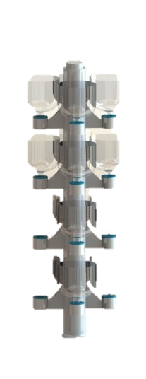
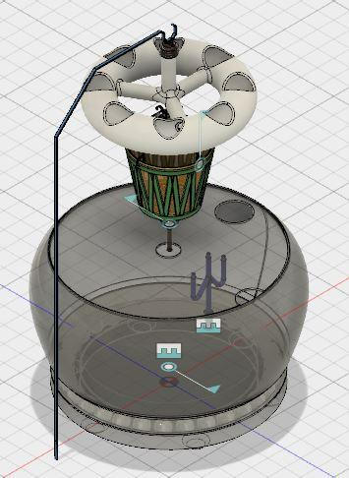
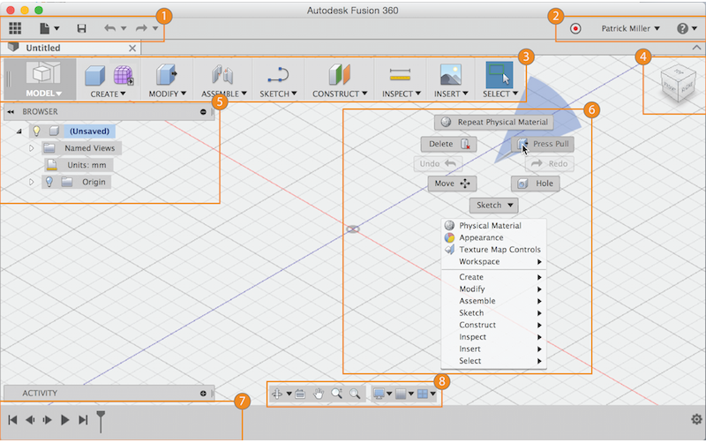

Future of Work
Youth collaborate on design
  Hydroponic systems for assisted living residents
  Electronic controls
  Augmented reality
  Fabricate

Slide 34
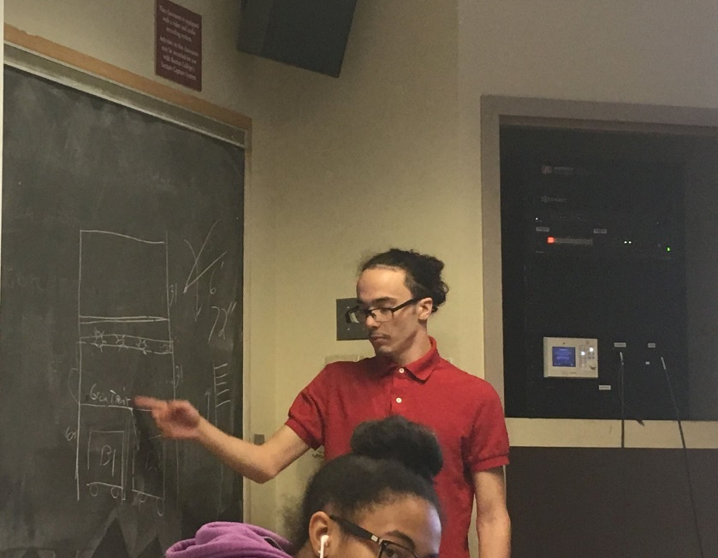
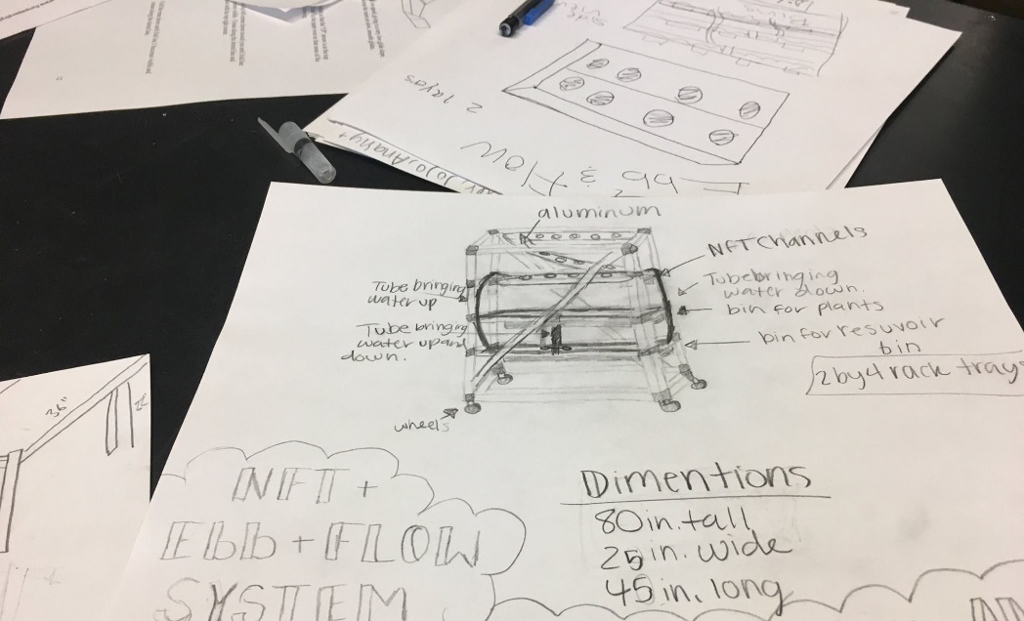
Changemakers: Scaling and Social Impact
New NSF award
  High school youth and College-age youth
    Food justice leaders to train food justice ambassadors (high school youth)
    Food justice ambassadors
      Teach middle school – out-of-school time
      1000 middle school youth selling produce at farmers markets and 80 food justice ambassadors throughout the state

Slide 35



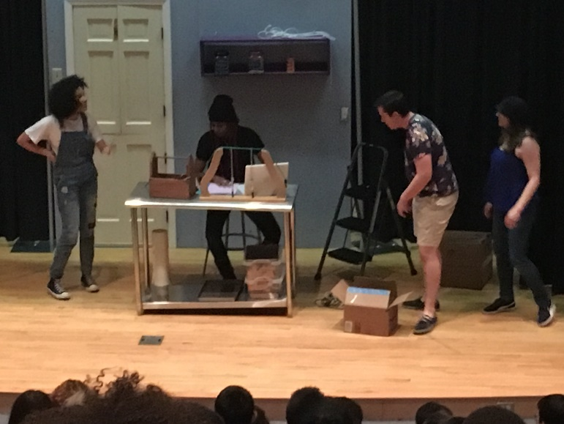
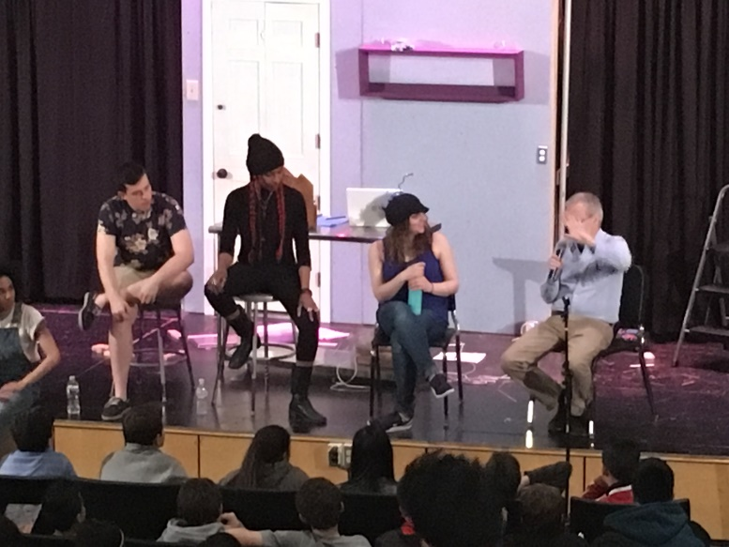
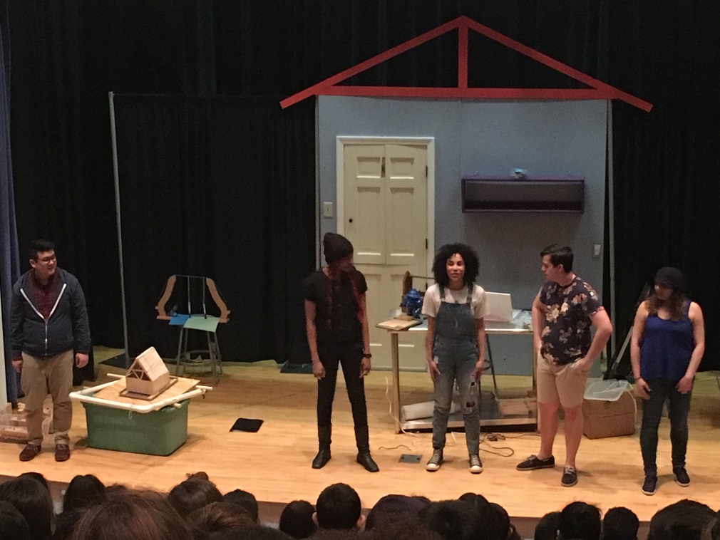
Converge Theatre Project
New Project
  One play done (Earthquakes)
  Next play goes live in Spring 2018
Shifting to focus on youth designing/writing/building
  Interested in examining as an alternative pathway
Preliminary findings
  “science youth” -> not a fan
  “Non-science youth” -> could see themselves being interested in science if science was more like the play

Slide 36
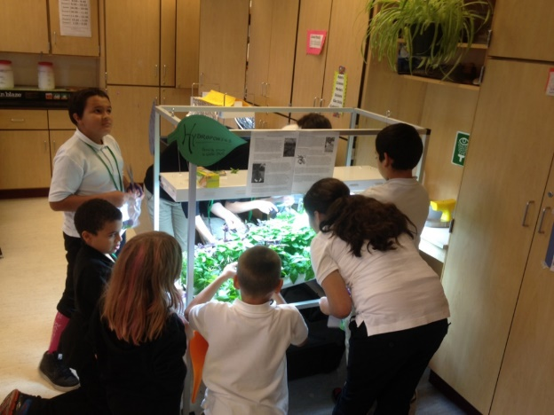
A Fantastic Team
Collaborating Faculty and Partners
  Rajeev Rupani – Lab Manager (Senior Research Associate)
  Dr. David Blustein – LSOE – Counseling Psychology
  Ms. Catherine Wong – Urban Outreach
  Dr. Eric Strauss – Urban Ecologist – Los Angeles (CURes)
  Dr. Alan Kafka – Earth and Environmental Science
  Dr. Belle Liang – Counseling Psychology, Boston College
  Dr. Laura Foote– CSOM – Social Entrepreneurship
  Dr. Laura O’Dwyer – LSOE- Educational Research/Measurement
Graduate Students
  Amy Semerjian – Statistics (Ed Measurement)
  Pablo Gonzalez – Statistics (Masters student)
  Christian Asante – Science Education (Transparent Soil)
  Chad Olle – Career Education (NSF ATE Led)
  Whitney Erby– Career Education – Changemakers
  Paul Xu – Educational Technology (Literacy/Robotics/Electronics – Lead)
  Anne Vera-Cruz – Science Education & Organizational Leadership (China – lead and curriculum lead)
  David Jackson – Lemelson-MIT/OST partnership
  Megan McKinley – Science Education
  Ariella Suchow – Converge Science Theatre

Slide 37
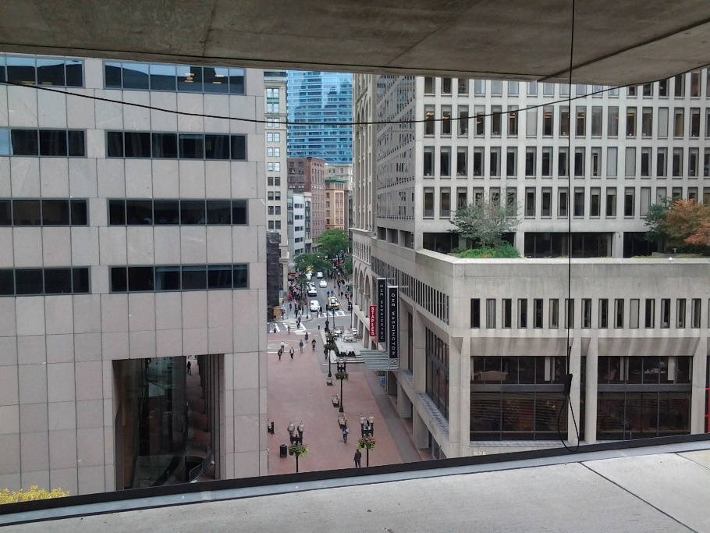
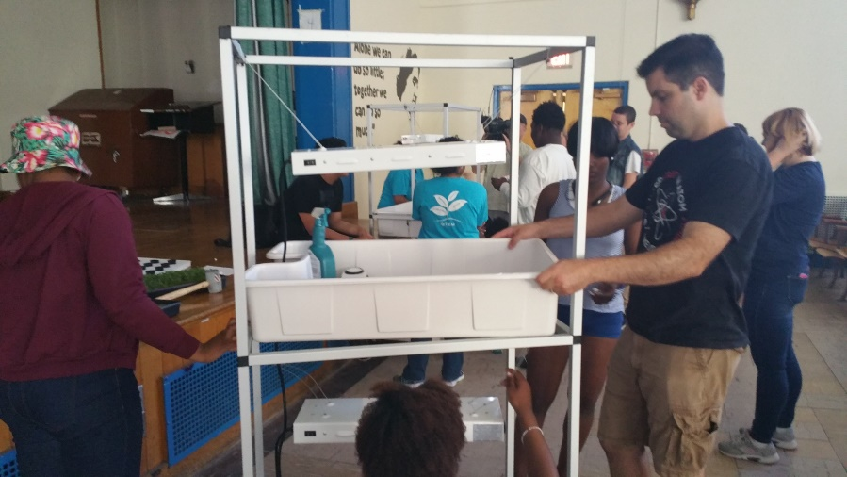
Partners
Public, Private, Non-Profits
  City of Boston – Mayors Office
  Los Angeles Mayor’s Office
  Boston Public Schools – OELL office
  MentorNet
  American Hydroponics
  GYOStuff
  General Hydroponics
  Wicked Device, LLC
  Placeways, LLC
  Codman Square Development Corporation
  Salvation Army
  Project LEAH (train high school to teach/mentor younger students)
  STEM Garden Institute
  Center for Urban Resilience and Sustainability – LMU-LA
  Helical Systems
  uFactory
  Massachusetts Bay Community College
  Groundworks USA
  MassRobotics
  The Daily Table
Common Core Goals
  Get youth interested and excited about science and to solve problems in their communities
  Create pathways for youth

Slide 38
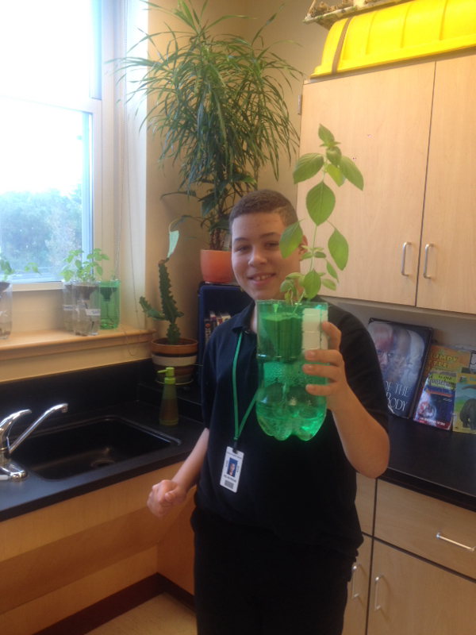
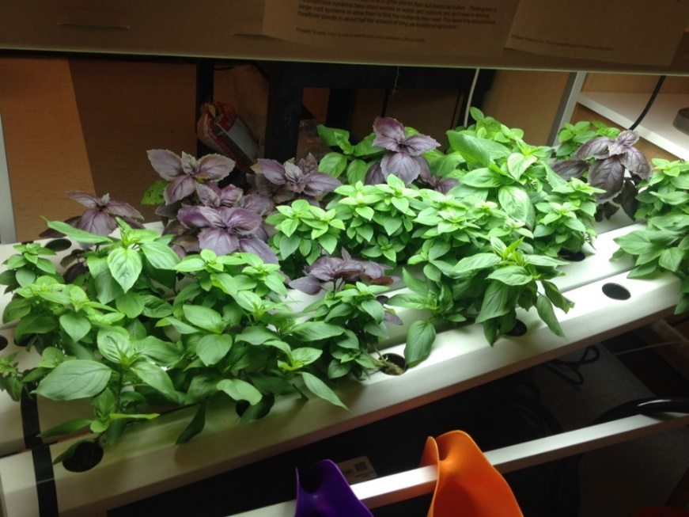
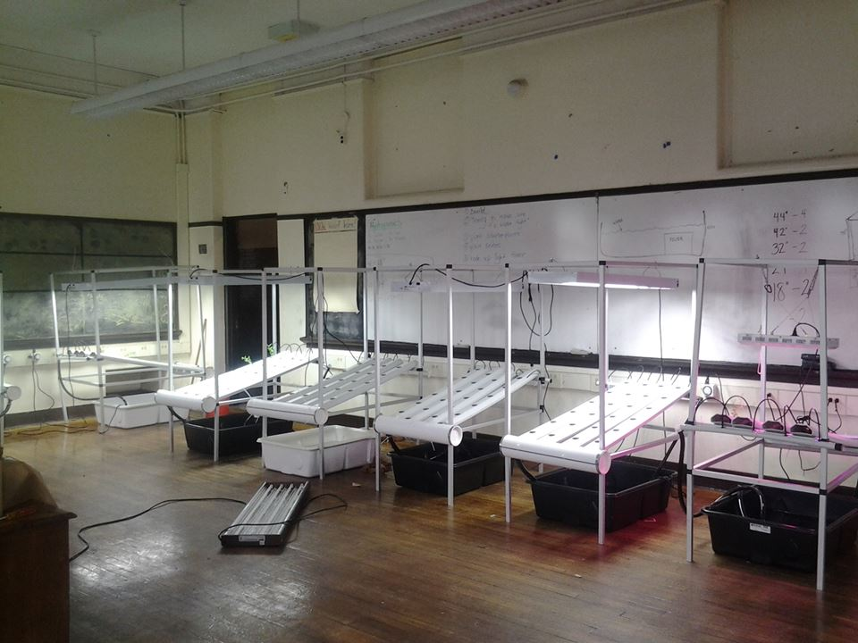
Thank you
Contact info
  http://iuse.bc.edu
  barnetge@bc.edu
  @mike_barnett_BC
  http://facebook.com/urbanhydrofarmers
  http://facebook.com/knowyourair
  http://facebook.com/STEMcareer

